Slide 1

Predicting Airline Passenger Satisfaction
Presented by: Raghav Gupta (301272406)

Slide 2
INTRODUCTION
Predicting airline passenger satisfaction will help airline companies to predict which factors lead to passenger satisfaction or dissatisfaction. Once airline companies get to know about these factors, they can work on them to make their passengers more satisfied with their services.

Slide 3
OBJECTIVES
The primary objective of this project is to find the model with the best accuracy which will help to predict passenger satisfaction.
This project will help to answer the following question:-
What are the key factors that significantly impact airline passenger satisfaction?

Slide 4
DATA OVERVIEW
The dataset includes 23 columns, with each column containing varied information related to passengers.
There are 103904 number of records in the dataset.
To derive meaningful insights, the relationship between the target variable and other variables is examined.
These observations aid us in constructing a model that aligns with the goals of this project.

Slide 5
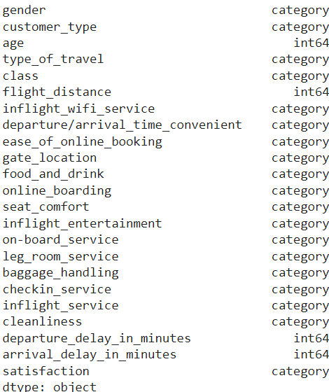
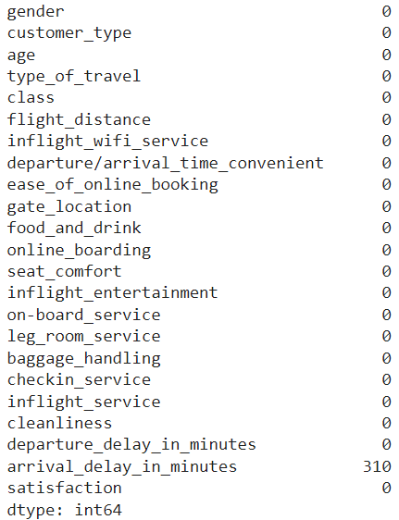
Data types and null values
In the data set there are 23 variables in which 4 are numeric and rest is categorical. There are 310 null values in arrival delay in minutes variable.

Slide 6
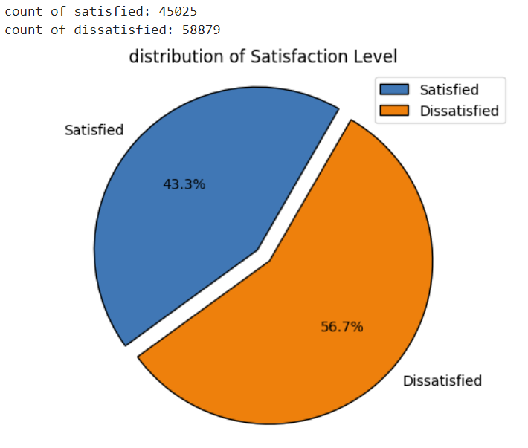

Slide 7
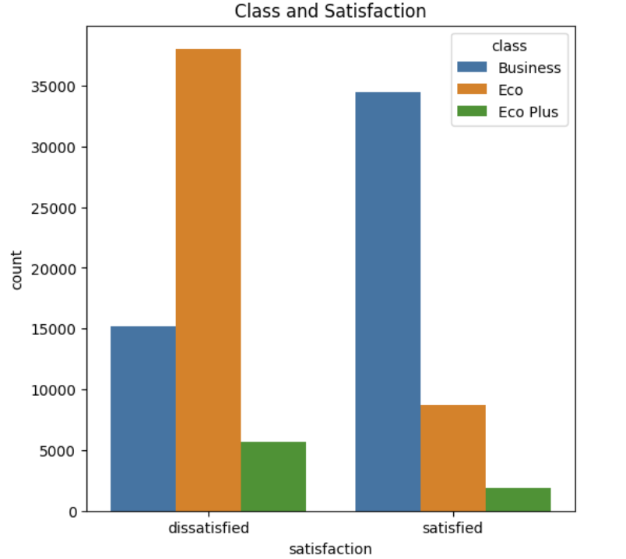
~35000 passengers are from the Business class which is satisfied and ~38000 passengers are from Eco class is dissatisfied.

Slide 8
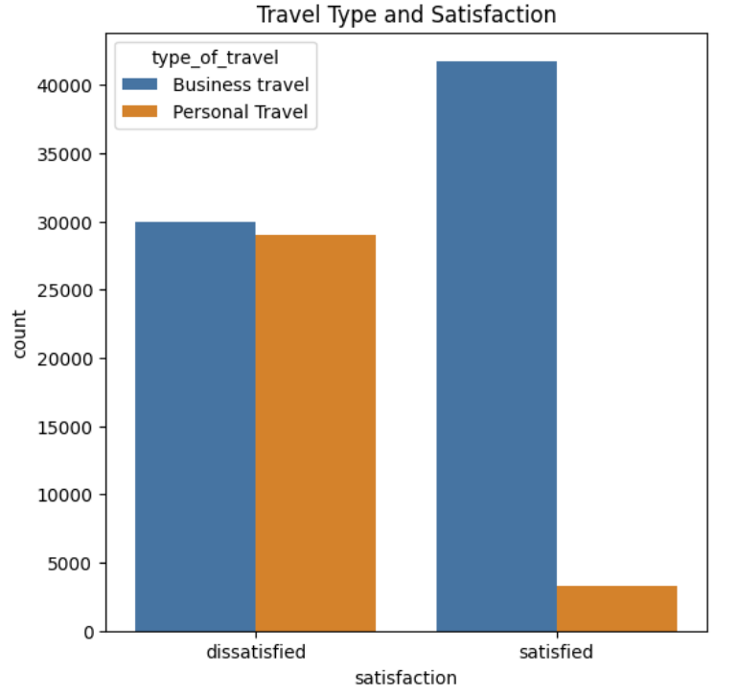
~42000 passengers who travel for their business purposes are satisfied and ~28000 passengers who are dissatisfied are from Eco Class which is far greater than satisfied passengers from the same category.

Slide 9
MODELS
I used various models in my project. These are as follows:-
MODELS | ACCURACY
Logistic Regression | 0.936
Random Forest | 0.96
Decision Tree | 0.94
Gradient Boosting | 0.95

Slide 10
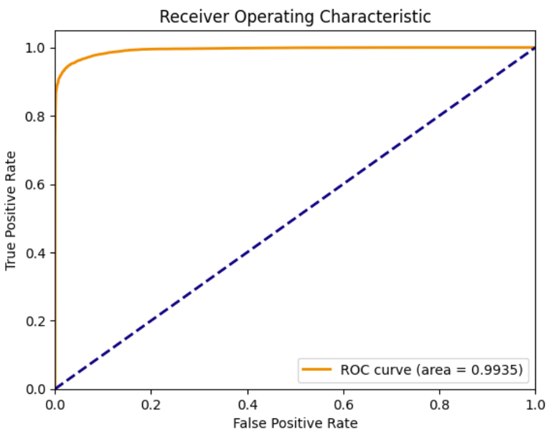
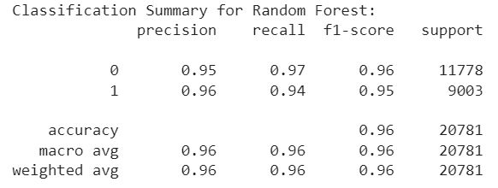
MODEL PERFORMANCE
After a thorough and complete evaluation, Random Forest was the best model on the basis of:-

Slide 11
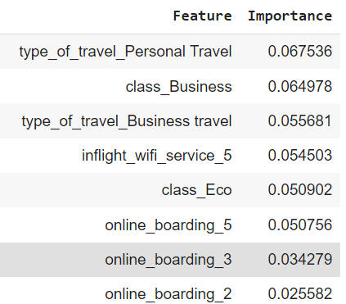
CONCLUSION
After evaluating the results of Random Forest, we can predict which factors have a significant impact on passenger satisfaction.

Slide 12
LIMITATIONS
Various information like carrier, cost, travel date, and flight capacity are not given in the dataset. These variables might have had an impact on the satisfaction of passengers.
The dataset lacks a specified timeframe for data collection, leaving us uncertain whether the information was gathered prior to or post the pandemic. Given the significant shifts in passenger preferences caused by the pandemic, this temporal context is crucial for accurate analysis.

Slide 13
FUTURE RECOMMENDATIONS
Hyperparameter tuning can be done for the optimized model.
More complex model might be deployed for higher accuracy.
Feature selection by creating a subset of existing features that are more informative.
Several other factors such as in-flight crew behavior, landing or take off, etcetera also affects passenger satisfaction, which should not be ignored.

Slide 14
THANK YOU
ANY QUESTIONS

